Slide 1

Cool Cosmetics

Slide 2
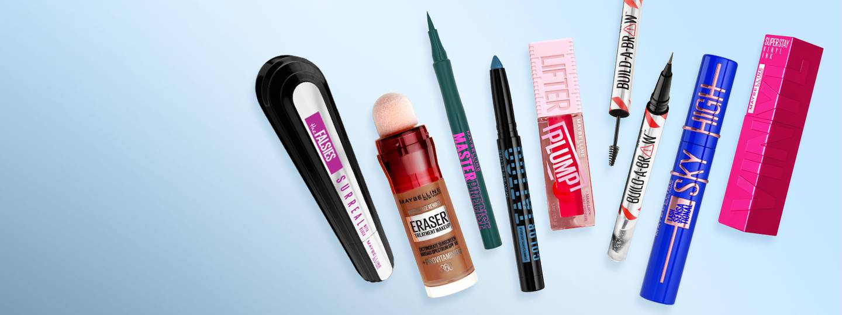
Table of Contents
INTRODUCTION
STATEMENT OF PROBLEM
MOTIVATION
OBJECTIVE
SCOPE AND LIMITATION
LITERATURE REVIEW
GENERIC MODEL
CONTEXT DIAGRAM
DATA FLOW DIAGRAM(DFD)
ER-DIAGRAM
SCREENSHOTS
TOOLS AND PLATFORM
CONCLUSION
FUTURE ENHANCEMENT

Slide 3
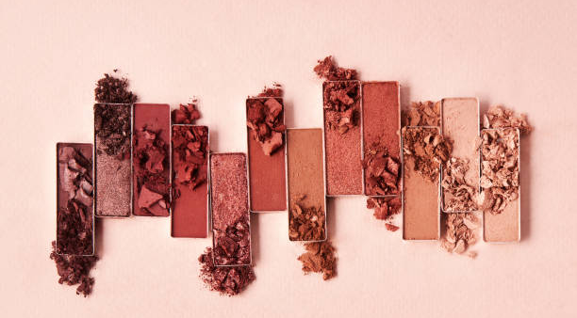


Introduction
An cosmetics shopping system website is a website designed, built and maintained by the admin for the users.
The purpose is to provide user friendly web pages that provide sufficient and full information about the beauty products.
Saving time is its main advantage.
Customers can easily browse and select from a wide range of cosmetic products, including skincare, hair care, makeup, and fragrance.

Slide 4
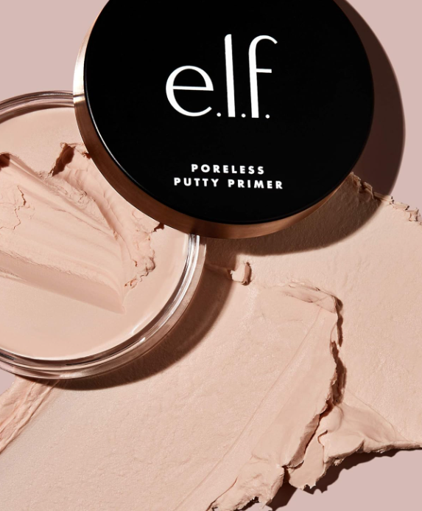
Statement of problem
Other website faces several critical issues that hinder its functionality and user experience.
The website suffers from inadequate information about products, making it challenging for users to make informed purchasing decisions.
The absence of labeled prices adds further frustration and uncertainty to the shopping experience. Lastly, the website’s low maintenance and infrequent updates contribute to a platform fails to meet the needs of evolving users.
Addressing these challenges is crucial to improving the website's performance, enhancing user trust, and increasing overall customer satisfaction.

Slide 5
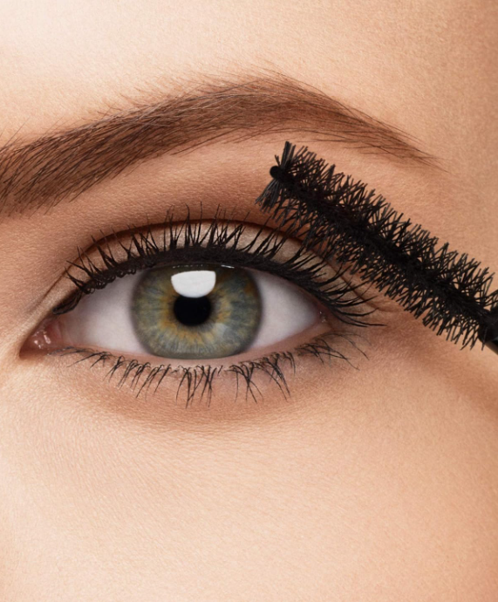
MOTIVATION
Beauty Products has become a essential part of our lives.
Easy product comparison and specification.
Secure transaction.
Saves a lot of time.

Slide 6
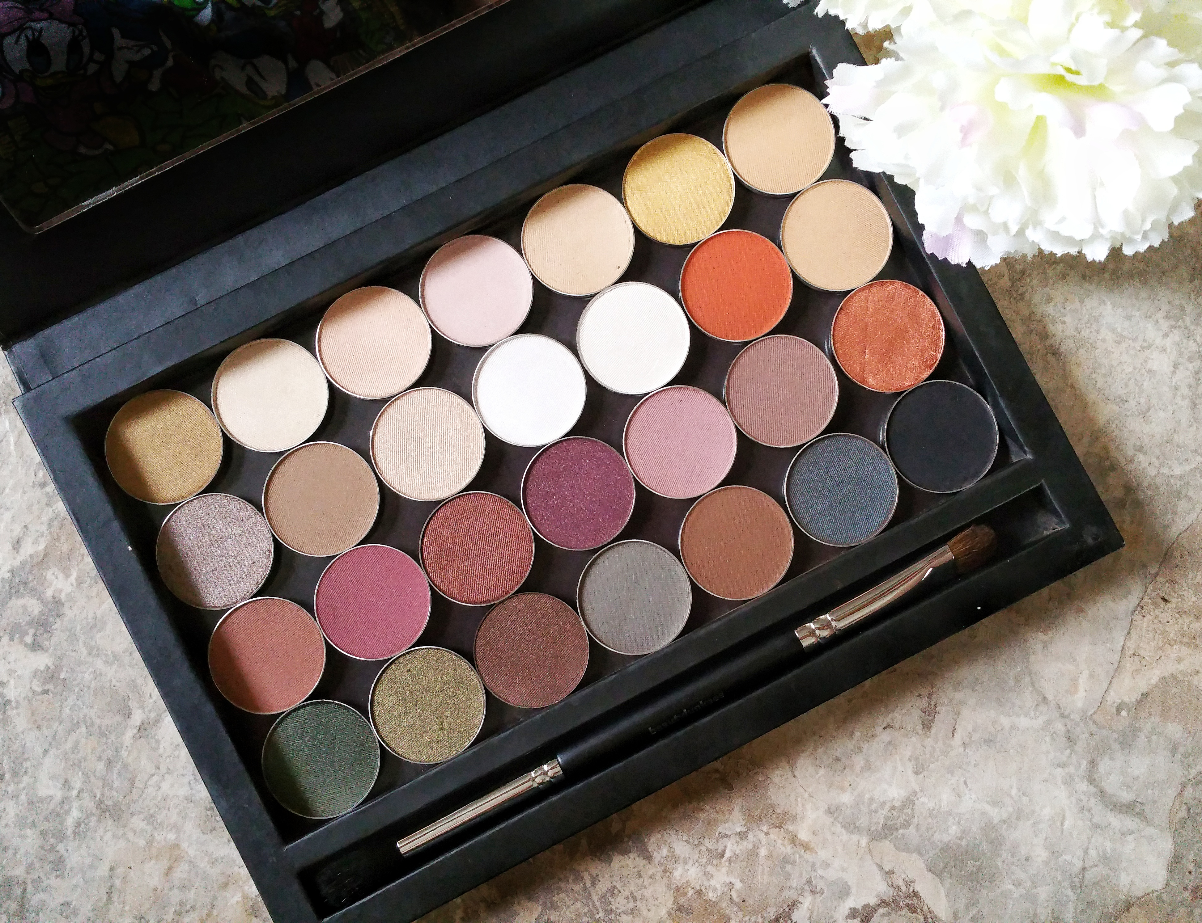
OBJECTIVE
Saves users time and effort of having to physically visit a store and allows users to easily compare prices and specifications.

Slide 7



Scope and Limitations
SCOPE:
Common people with slight knowledge of internet and application can be able to use it.
Proper information of laptop and mobiles will be given to the user with proper specification and prices.
It is online based system.

Slide 8



Scope and Limitations
LIMITATION:
The customers must compulsory logged into their accounts to buy laptop and mobile.

Slide 9

Literature Review
Cosmetics has become increasingly popular due to its convenience and wide range of options
Online shopping is like a boon for customers who have very less time and are extremely busy due to their hectic life.
Benefits like time-saving, home delivery, large variety, easy payment, saving of cost etc to its customers
“Today’s online shopping experience starts and ends with the customer. We have a wealth of data at our fingertips and use it to understand what customers are looking for and why they shop and respond the way they do”

Slide 10
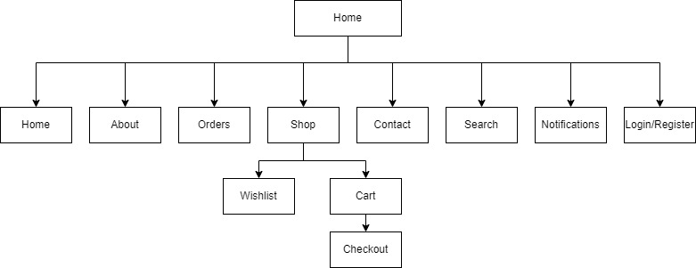
Generic model
User Panel
Here this is a generic model for user panel. Here a user will get a interface, which contains home page, about us page, order detail page, shop page, contact page, search page, notifications button, and login or register page so that user can buy products from the store and access wish list and cart options.

Slide 11
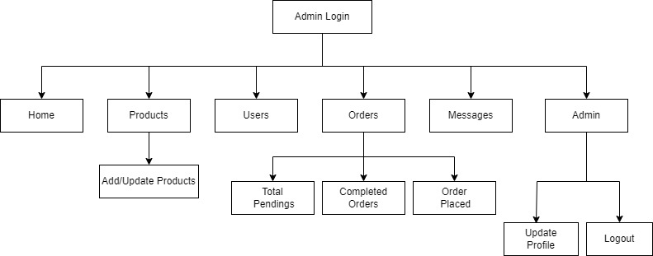
Generic model
Admin Panel
Here this is a generic model for admin panel. This interface is only available to admins. It contains a dashboard where we can add/update products, see total users who had login to the system, what user had ordered, the feedback from customers and update the profile of admin also.

Slide 12
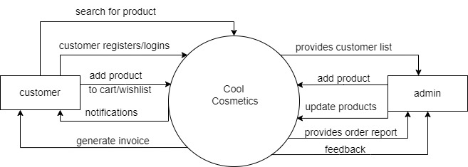
Context diagram

Slide 13
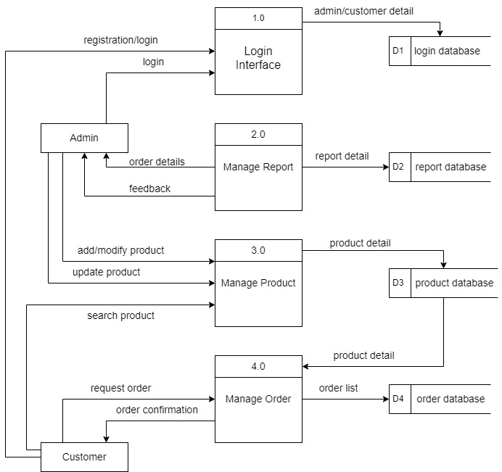
DFD(Data Flow Diagram)

Slide 14
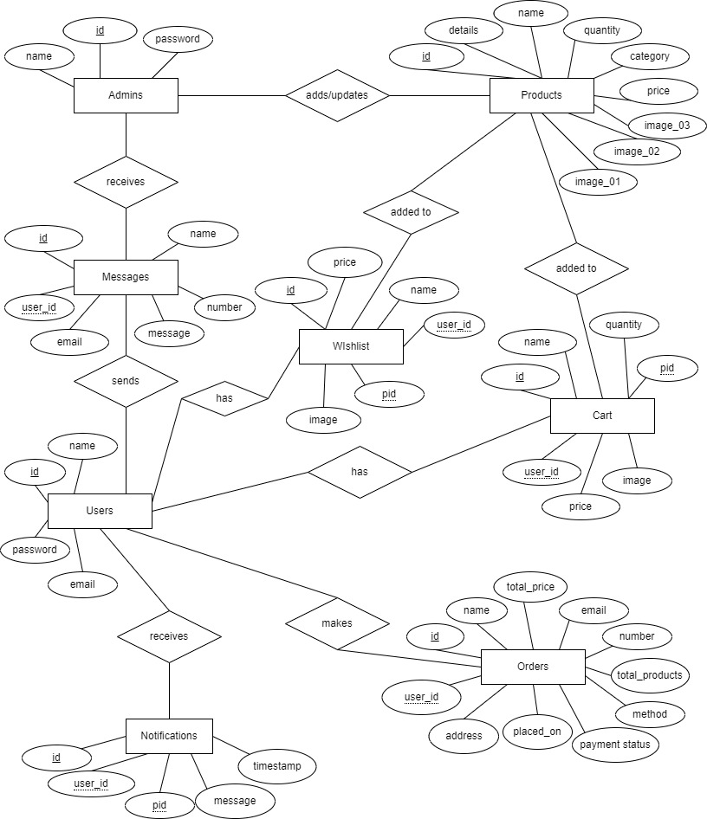
ER Diagram

Slide 15



Screenshots
We have prepared project on “Cool Cosmetics” using HTML, CSS, PHP and DATABASE. This project has provided information about cosmetics related products like its price, size etc. Some screenshots of this project are:

Slide 16
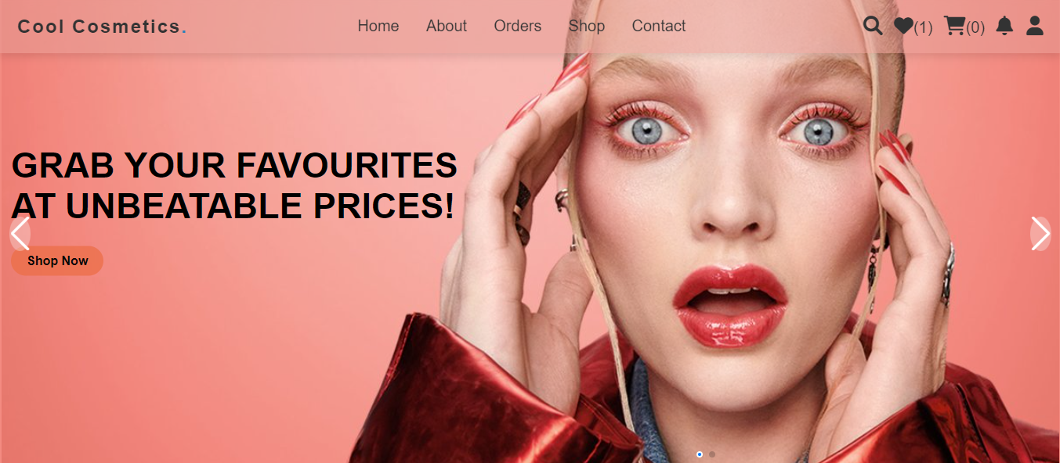
Home Page
This the primary page of a website where customers can view the categories of the products as well as the products. They can check their orders, contact us, learn more about us and search the required products.

Slide 17
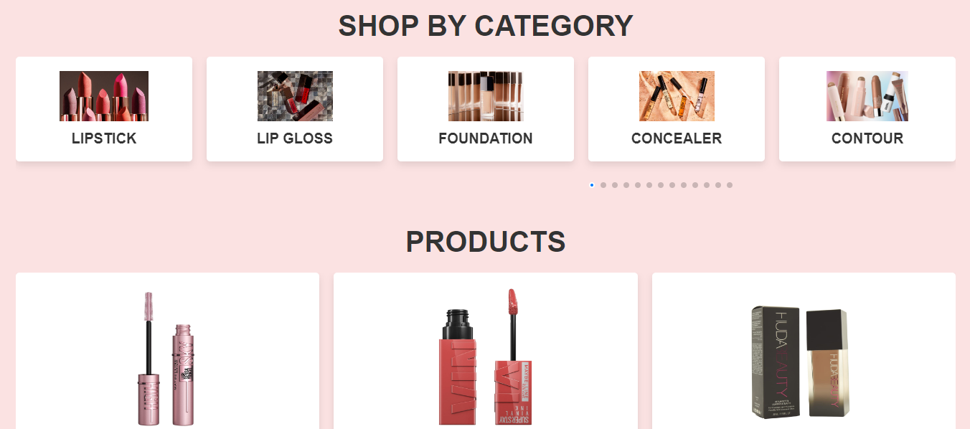
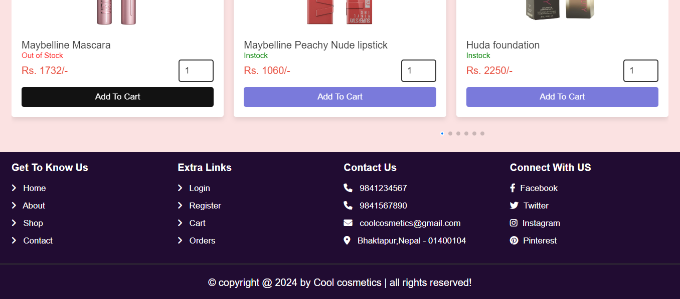

Slide 18
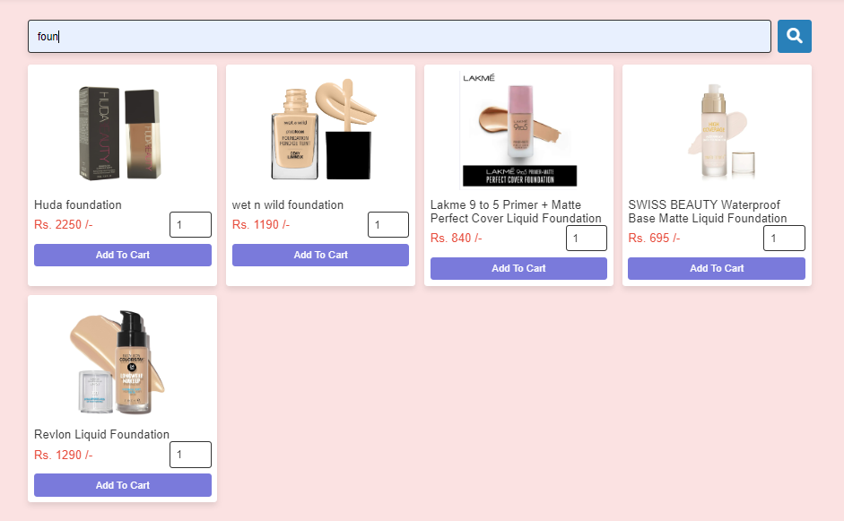
Search Page
In this page we can search products that are available in our site.

Slide 19
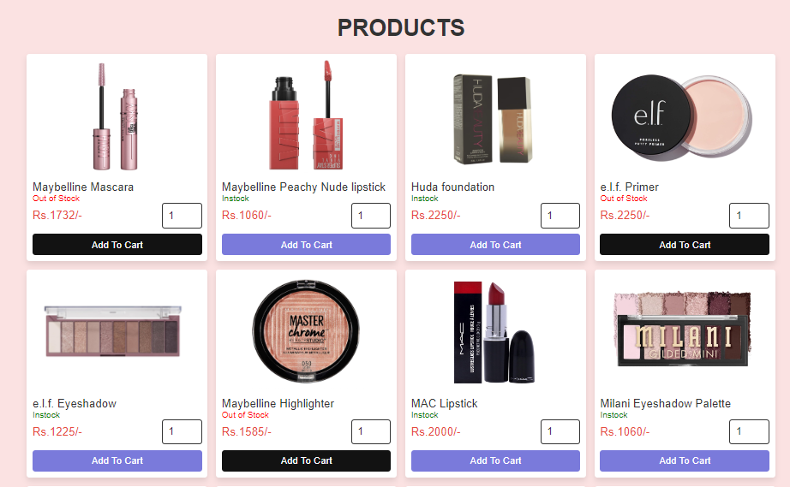
Shop Page
Here all the products available in our shopping site are included with their prices and name.

Slide 20
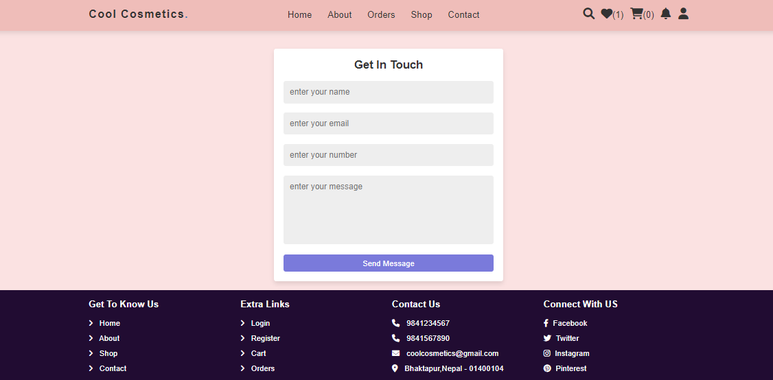
Contact Page
This is a contact page where customer can sent their messages and feedback.

Slide 21
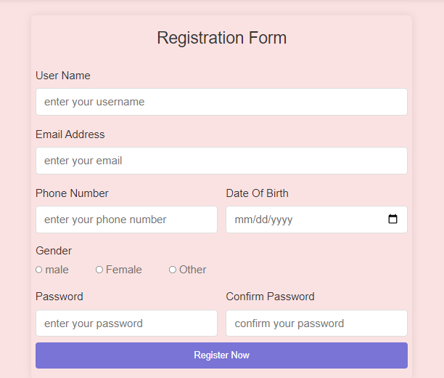
Registration Page
This is a registration page where customer have to enter their information for further process.

Slide 22
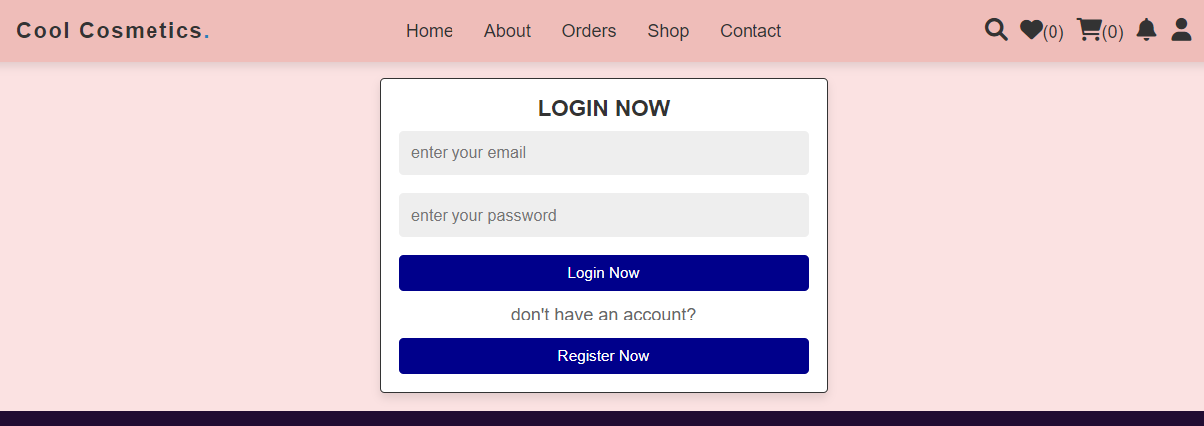
Login Page
This is a login page where customer have to login for buying products from shopping system.

Slide 23
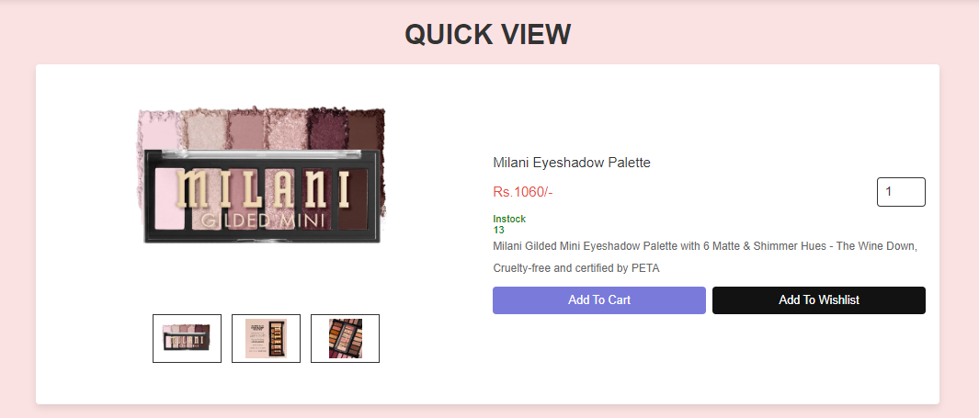
Quick View of Products
Here customer can see the items available in the store, with full view of products and their details like quantity, price etc.

Slide 24
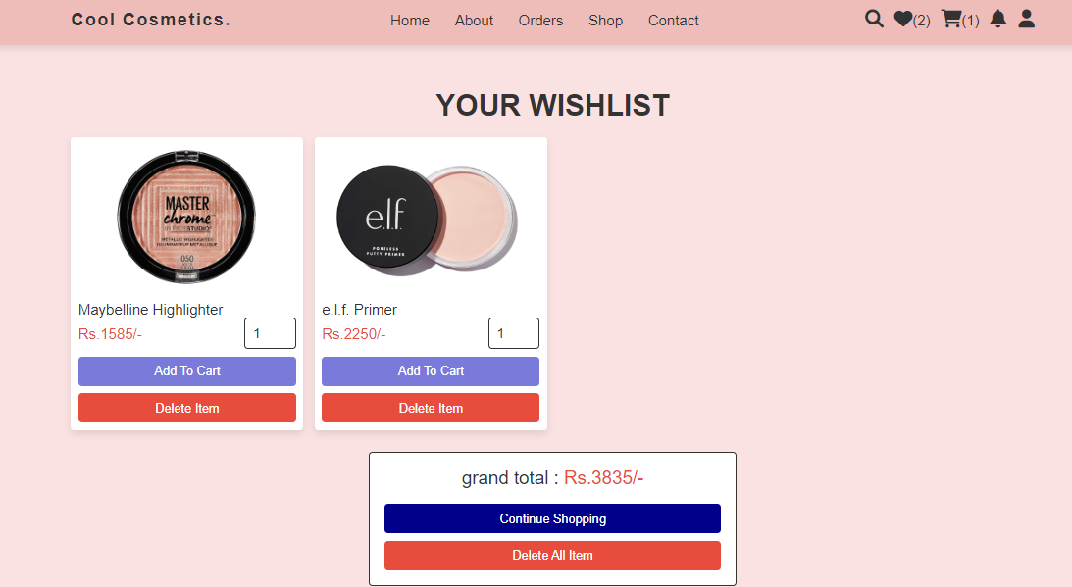
Wishlist
Items we wish to buy, so that further item can be added to cart easily are added to wish list page.

Slide 25
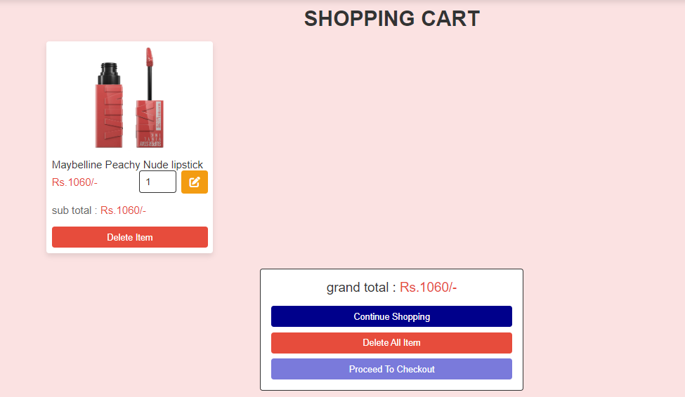
Cart Page
Items added to cart are displayed in this page and is further sent for checkout process.

Slide 26
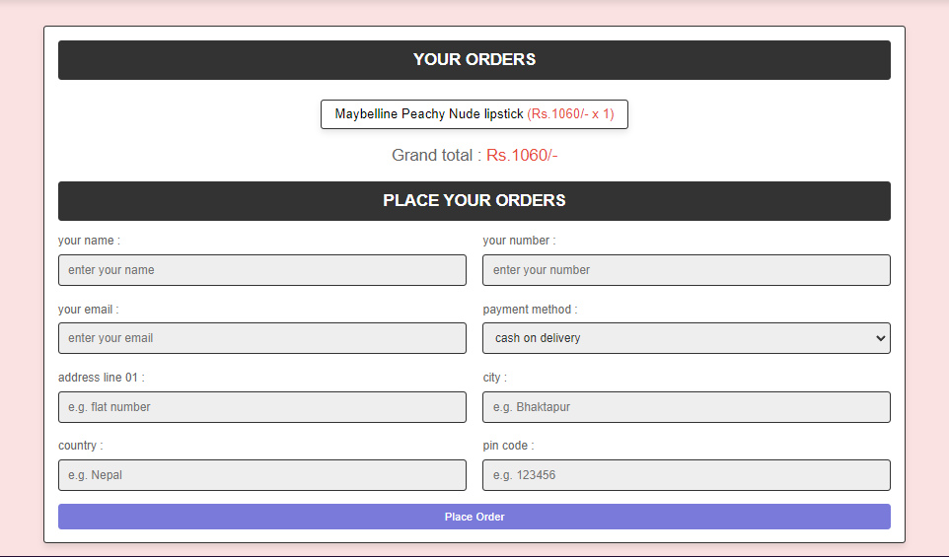
Checkout Page
After adding items to cart, it is further sent to this checkout page for placing order.

Slide 27
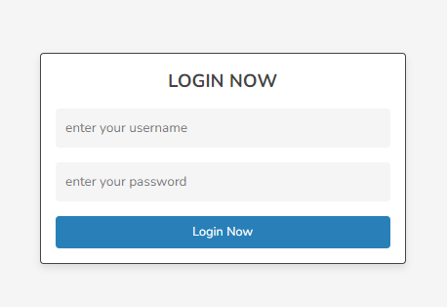
Admin Login Page
This is the admin login page where admin can manage products details, order details, can see messages and many more.

Slide 28
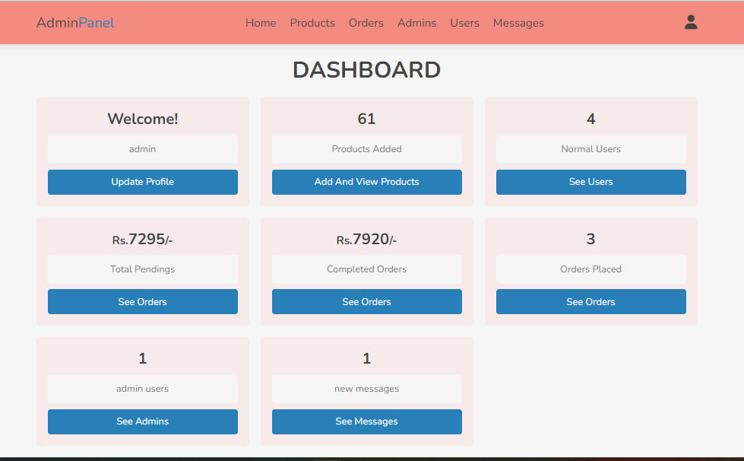
Dashboard

Slide 29
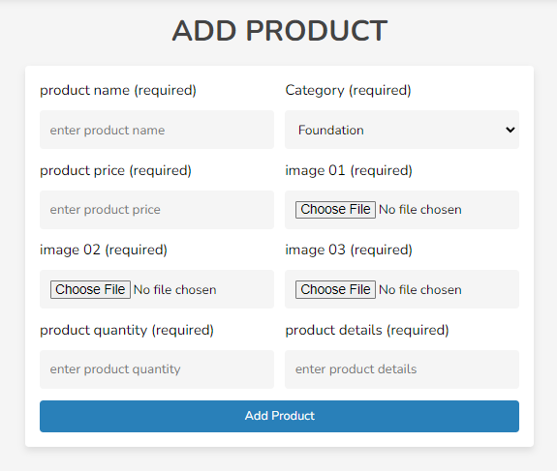
Product Page
Here admin can add and update their products details as available in store.

Slide 30
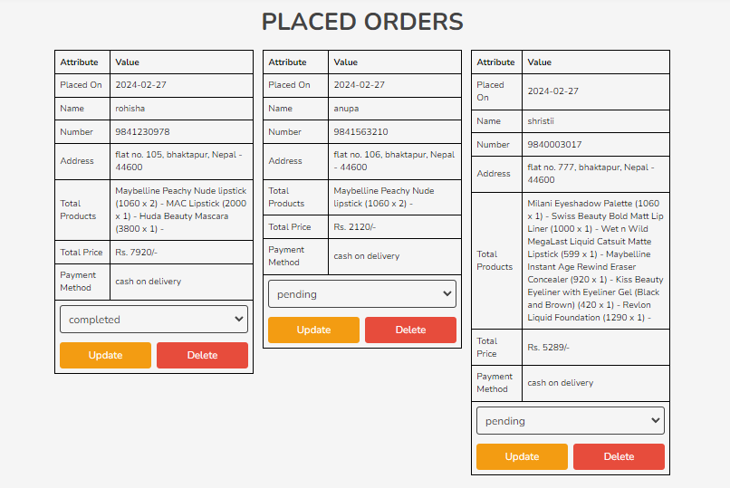
Order Placed Page
Here admin will see what customer had placed order and update as completed when delivered.

Slide 31
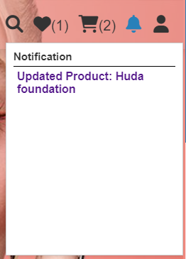
Notification Page
.

Slide 32
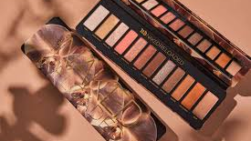

Tools and Platform
Software
➢ MySQL, HTML, CSS, JS,PHP
Platform
➢ Windows

Slide 33
CONCLUSION
We got more familiar with the concept of web development.
Had been a good learning experience for us to enhance and explore our abilities and knowledge in the field of web development.
Still the website is not complete by itself but there will be always space for improvement.
More features may be added to make it more attractive and user-friendly.

Slide 34
FUTURE ENHANCEMNET
Since this project was started with very little knowledge about the online shopping and how it works.
A complete and useful project can only be developed with lot of intensive effort and time and due to the limitation of time, we came to know about the enhancement capability during the process of building it.
Some of the scope we can increase for the betterment and effectiveness are listed below:
Add payment methods
Sign in through Facebook/ Google
Making more user friendly.

Slide 35
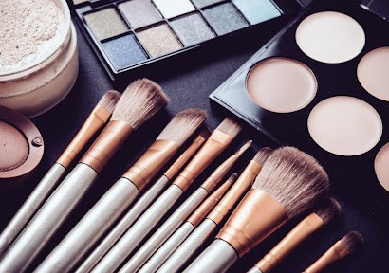
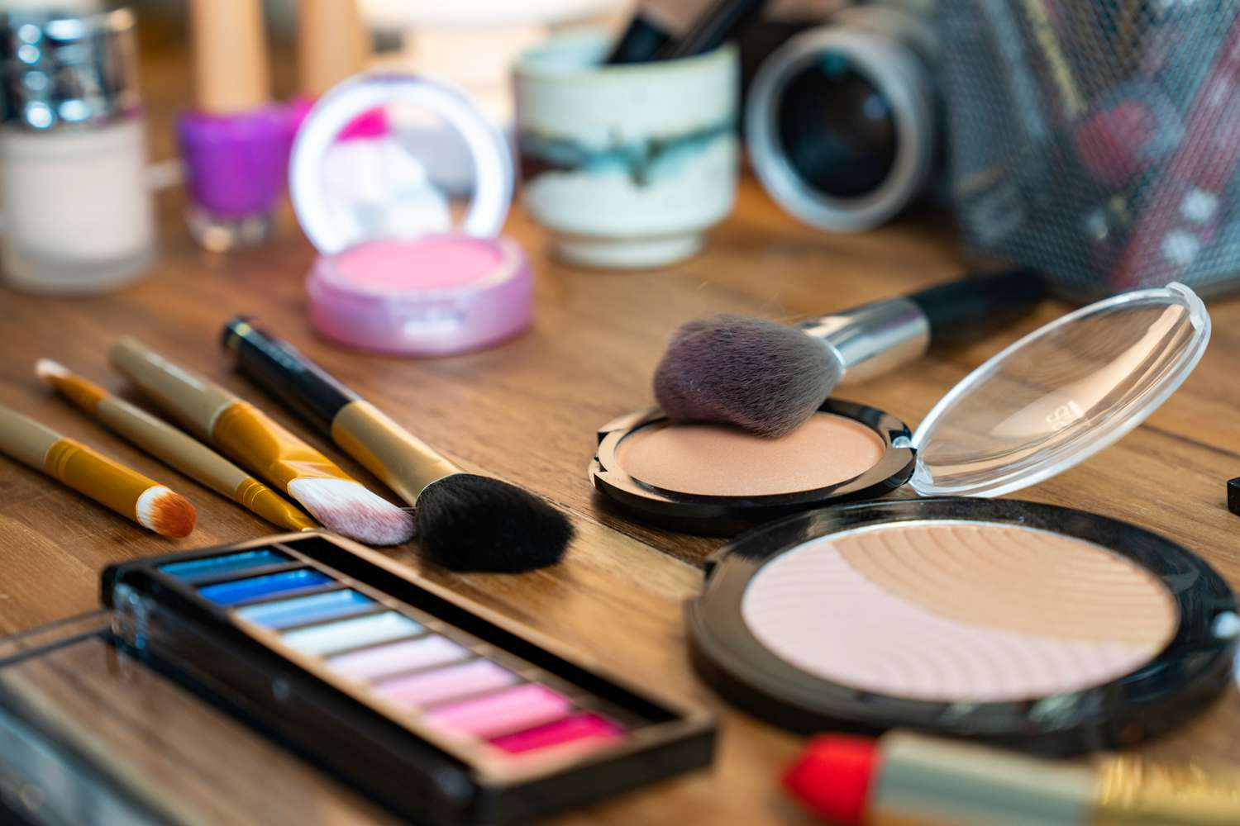
Thank you

